Slide 1
Core Spring 4.x
Rajeev Gupta MTech CS
Java Trainer & Consultant

Slide 2
Agenda
Introduction to Spring framework
Dependency Injection using xml
Constructor, setter injection
C and p namespace
Scopes
Autowire
Collection mappings
Bean factory vs application context
Splitting configuration in multiple files
Bean life cycle
Dependency Injection using annotation
@Autowired , @Qualifier, @Resource, @PostConstruct , @Predestroy, @Service, @Repository
Dependency Injection using java configuration
AnnotationConfigApplicationContext
@Configuration, @Bean, @Import, @Scope
@PropertySources
Using Environment to retrieve properties
Using Java configuration
What are Profiles?
Activating profiles

Slide 3
Agenda
Introduction to Spring framework
Dependency Injection using xml
Constructor, setter injection
C and p namespace
Scopes
Autowire
Collection mappings
Bean factory vs application context
Splitting configuration in multiple files
Bean life cycle
Dependency Injection using annotation
@Autowired , @Qualifier, @Resource, @PostConstruct , @Predestroy, @Service, @Repository
Dependency Injection using java configuration
AnnotationConfigApplicationContext
@Configuration, @Bean, @Import, @Scope
@PropertySources
Using Environment to retrieve properties
Using Java configuration
What are Profiles?
Activating profiles

Slide 4
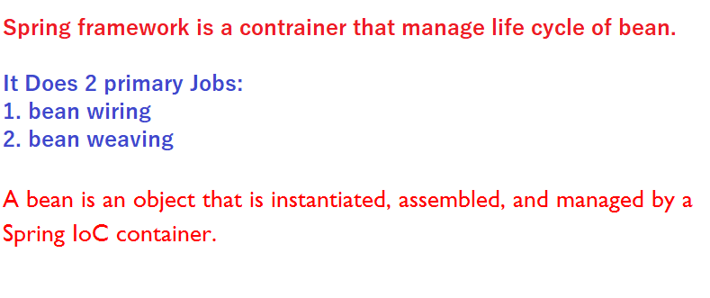

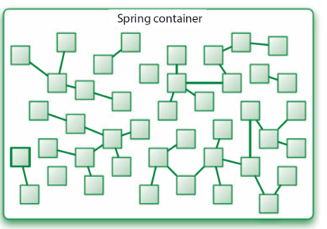
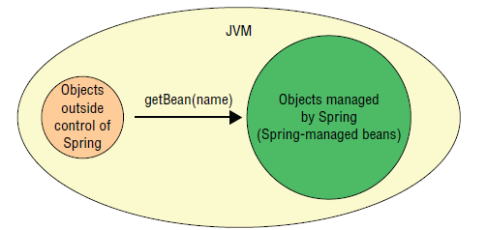
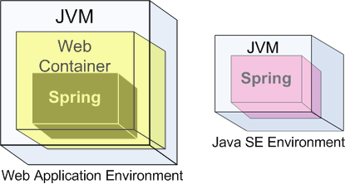

What is spring framework?

Slide 5
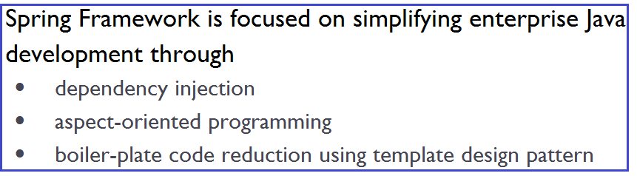
Why Spring framework?
Spring framework can be summarized in two ways:
Spring as and Container
Light weight container that do not need any installation, configurations start/stop activities.
Just collection of some jars
Spring an framework provides API
To integrate various technologies

Slide 6
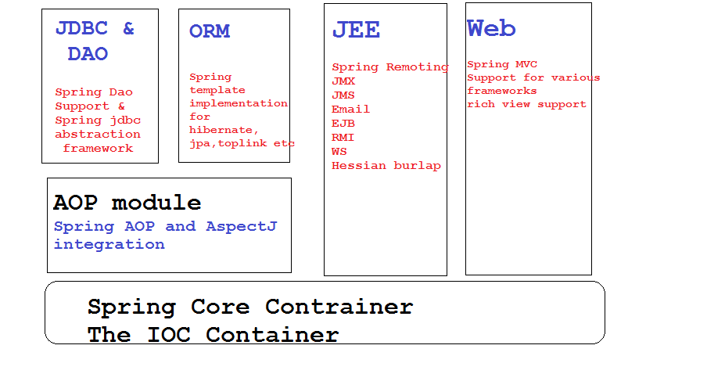
Some of Spring modules

Slide 7
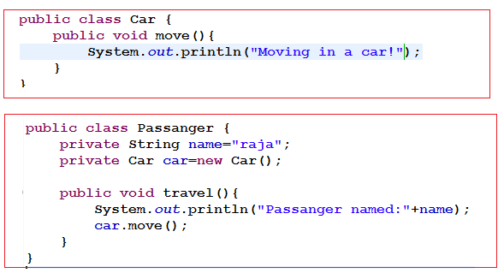
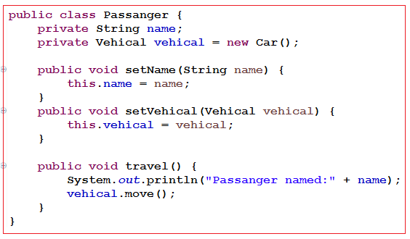
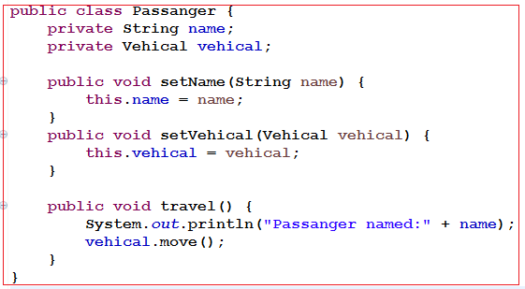
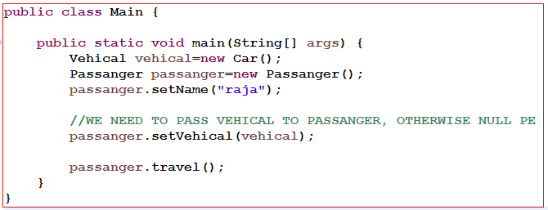
Need Of DI? An passenger need to travel
Attempt 1: Attempt 2:
Attempt 3: Supplying vehicle from outside world

Slide 8
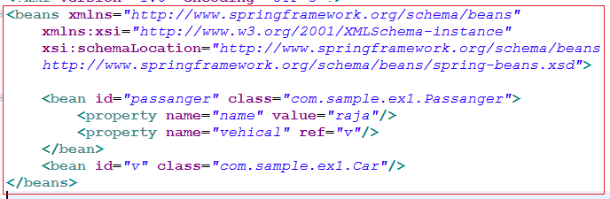

Need Of DI? An passenger need to travel

Slide 9
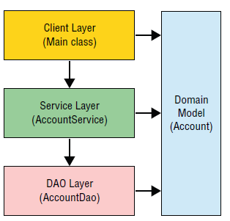


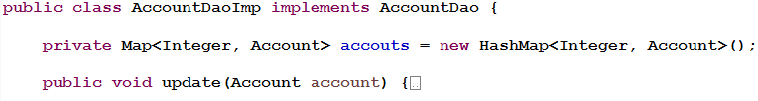

Bank Application

Slide 10
Agenda
Introduction to Spring framework
Dependency Injection using xml
Constructor, setter injection
C and p namespace
Scopes
Autowire
Collection mappings
Bean factory vs application context
Splitting configuration in multiple files
Bean life cycle
Dependency Injection using annotation
@Autowired , @Qualifier, @Resource, @PostConstruct , @Predestroy, @Service, @Repository
Dependency Injection using java configuration
AnnotationConfigApplicationContext
@Configuration, @Bean, @Import, @Scope
@PropertySources
Using Environment to retrieve properties
Using Java configuration
What are Profiles?
Activating profiles

Slide 11


Dependency Injection Using XML
Setter Injection
Constructor Injection
c namespace
p namespace

Slide 12
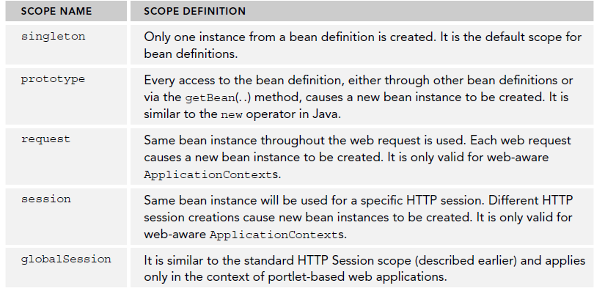
Bean Scopes

Slide 13
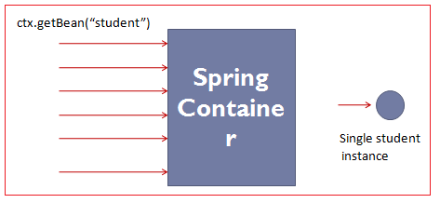
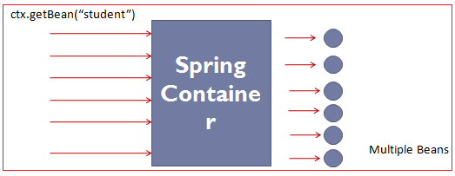
Singleton vs Prototype

Slide 14
Autowiring
AKA shortcut.
Default mode: Auto-Wiring "no"
Type of auto wiring: byName, byType

Slide 15
Collection Mapping
Collection mapping supported by Spring :
List:<list> - </list>
Set:<set> - </set>
Map:<map> - </map>
Properties:<props> - </props>

Slide 16

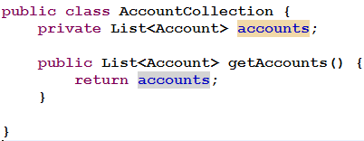
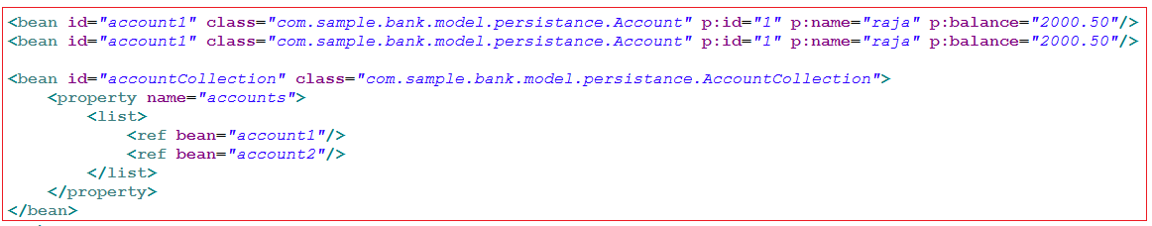
List Collection Mapping

Slide 17
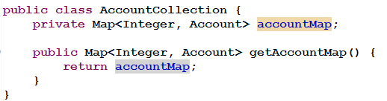
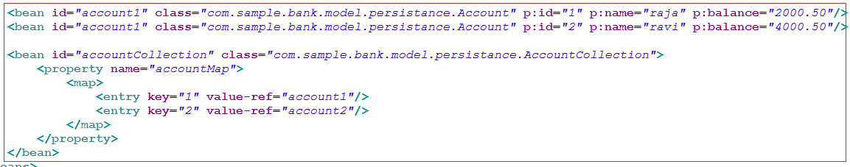
Map Collection mapping

Slide 18
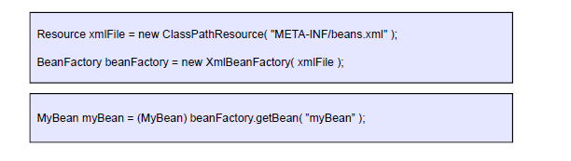
BeanFactory
Provides basic support for dependency injection
Lightweight
XMLBeanFactory most commonly used implementation

Slide 19
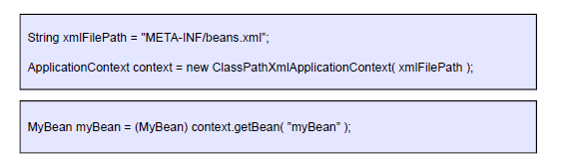
ApplicationContext
Built on top of the BeanFactory
Provides more enterprise-centric functionality
Internationalization of messages
AOP, transaction management
Preferred over the BeanFactory in most situations
Most commonly used implementation is the ClassPathXmlApplicationContext
ApplicationContext context = new FileSystemXmlApplicationContext("c:/foo.xml");
ApplicationContext context = new ClassPathXmlApplicationContext("foo.xml");

Slide 20
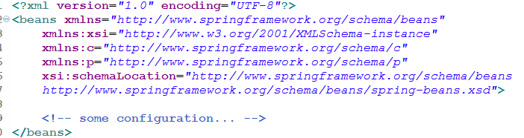

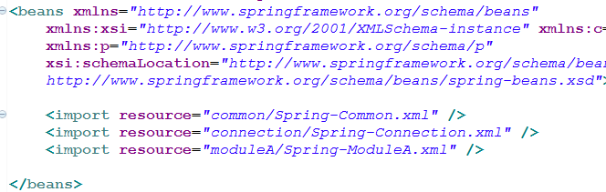
Splitting configuration in multiple file
bean1.xml bean2.xml
Better solution:-

Slide 21
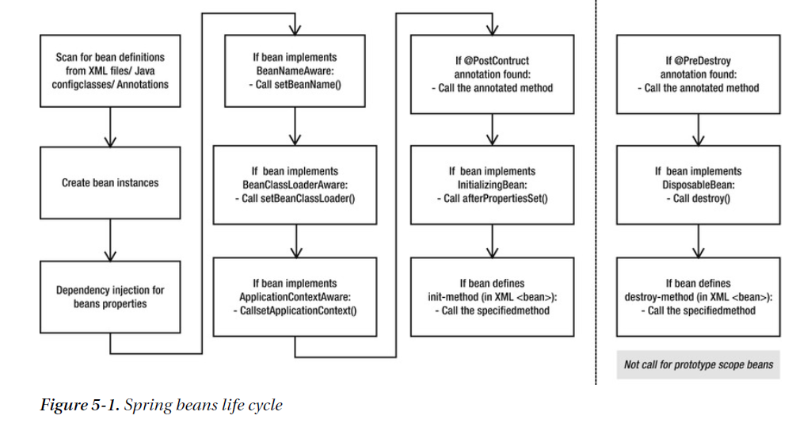
Spring bean life cycle

Slide 22
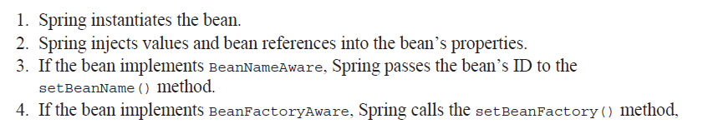
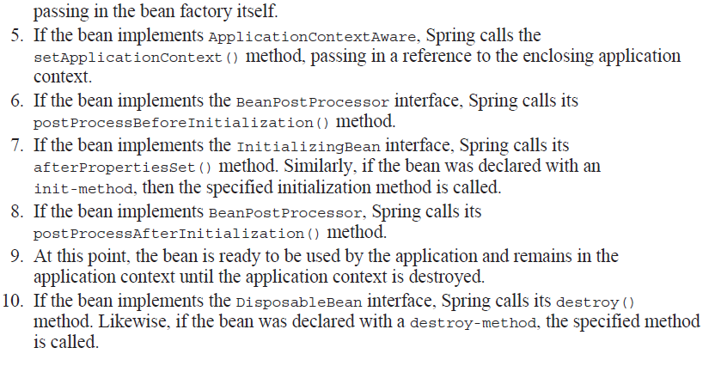
Beans Life cycle

Slide 23
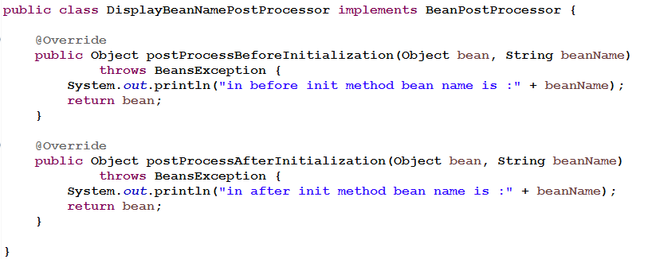
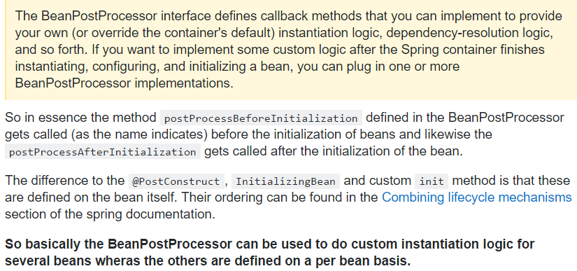
BeanPostProcessor

Slide 24
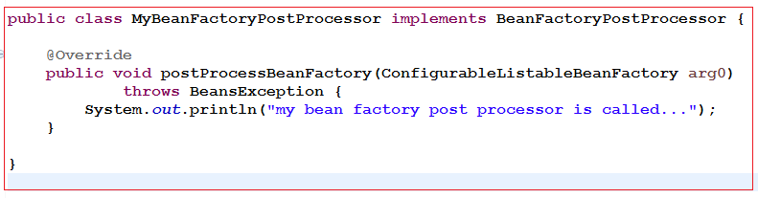
BeanFactoryPostProcessor
BeanFactoryPostProcessor is invoked before bean factory is initilized (and before any bean is initialized)
There are many BeanFactoryPostProcessor available by default in spring framework such as PropertyPlaceholderConfigurer
PropertyPlaceholderConfigurer is used to read values form properties files before initilization of beanfactory
Configuration

Slide 25
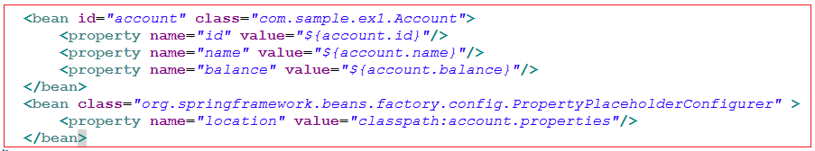


PropertyPlaceHolderConfigurer

Slide 26
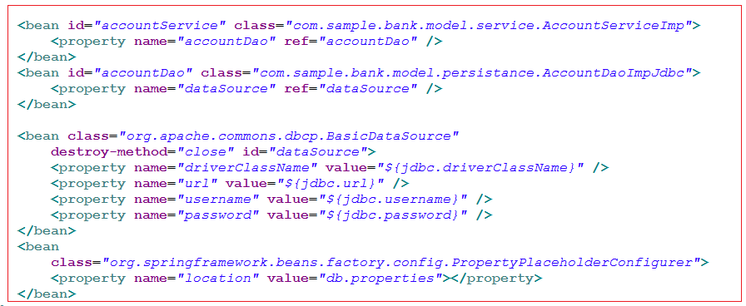
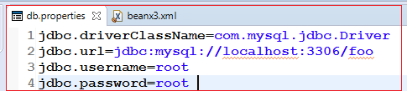
PropertyPlaceHolderConfigurer:DB Configureation

Slide 27
Agenda
Introduction to Spring framework
Dependency Injection using xml
Constructor, setter injection
C and p namespace
Scopes
Autowire
Collection mappings
Bean factory vs application context
Splitting configuration in multiple files
Bean life cycle
Dependency Injection using annotation
@Autowired , @Qualifier, @Resource, @PostConstruct , @Predestroy, @Service, @Repository
Dependency Injection using java configuration
AnnotationConfigApplicationContext
@Configuration, @Bean, @Import, @Scope
@PropertySources
Using Environment to retrieve properties
Using Java configuration
What are Profiles?
Activating profiles

Slide 28
Dependency Injection using annotations
@Value - to inject a simple property
@Autowire -to inject a property automatically
@Component:@Controller @Service and @Repository
@Qualifier - while autowiring, fix the name to an particular bean
@Required - mandatory to inject, apply on setter
@PostConstructs- Life cycle post
@PreDestroy- Life cycle pre
JSR 250 Annotations:
@Resource, @PostConstruct/ @PreDestroy, @Component
JSR 330 Annotations:
@Named annotation in place of @Resouce
@Inject annotation in place of @Autowire

Slide 29
Agenda
Introduction to Spring framework
Dependency Injection using xml
Constructor, setter injection
C and p namespace
Scopes
Autowire
Collection mappings
Bean factory vs application context
Splitting configuration in multiple files
Bean life cycle
Dependency Injection using annotation
@Autowired , @Qualifier, @Resource, @PostConstruct , @Predestroy, @Service, @Repository
Dependency Injection using java configuration
AnnotationConfigApplicationContext
@Configuration, @Bean, @Import, @Scope
@PropertySources
Using Environment to retrieve properties
Using Java configuration
What are Profiles?
Activating profiles

Slide 30
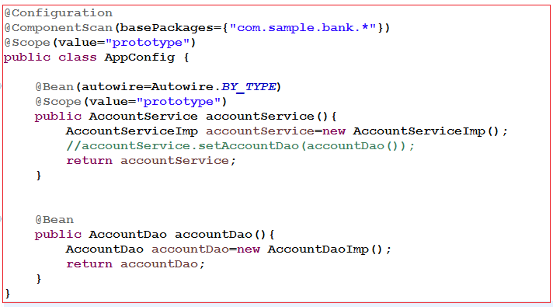
DI using Java Configuration

Slide 31
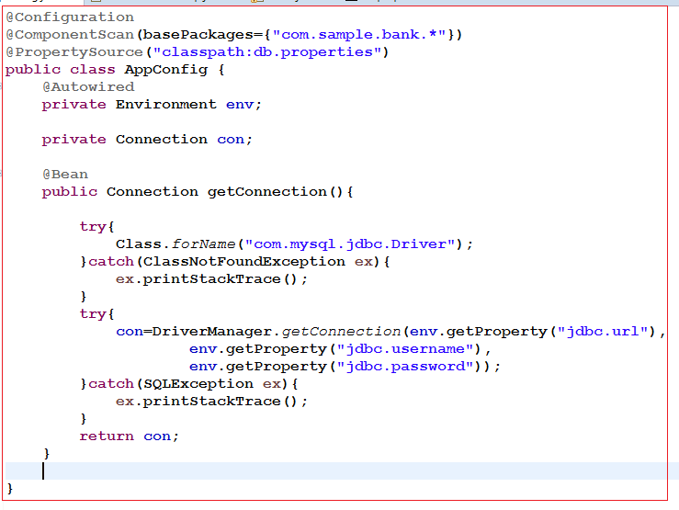

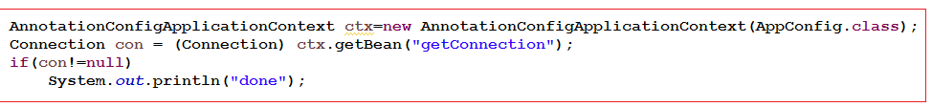
@PropertySource & Using Environment to retrieve properties

Slide 32
Agenda
Introduction to Spring framework
Dependency Injection using xml
Constructor, setter injection
C and p namespace
Scopes
Autowire
Collection mappings
Bean factory vs application context
Splitting configuration in multiple files
Bean life cycle
Dependency Injection using annotation
@Autowired , @Qualifier, @Resource, @PostConstruct , @Predestroy, @Service, @Repository
Dependency Injection using java configuration
AnnotationConfigApplicationContext
@Configuration, @Bean, @Import, @Scope
@PropertySources
Using Environment to retrieve properties
Using Java configuration
What are Profiles?
Activating profiles

Slide 33
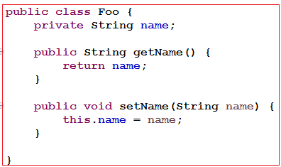
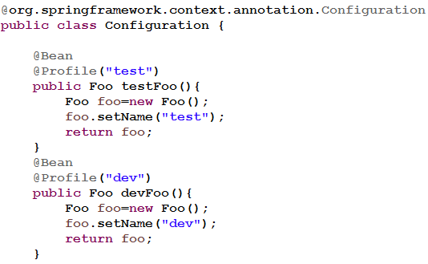
Profile Using Java configuration
What are Profiles?
@Profile allow developers to register beans by condition
We require to use caching in our book application we want to support two profile "dev" and "production"
If profile “dev” is enabled, return a simple cache manager ConcurrentMapCacheManager
If profile "production" is enabled, return an advanced cache manager – EhCacheCacheManager

